Slide 1
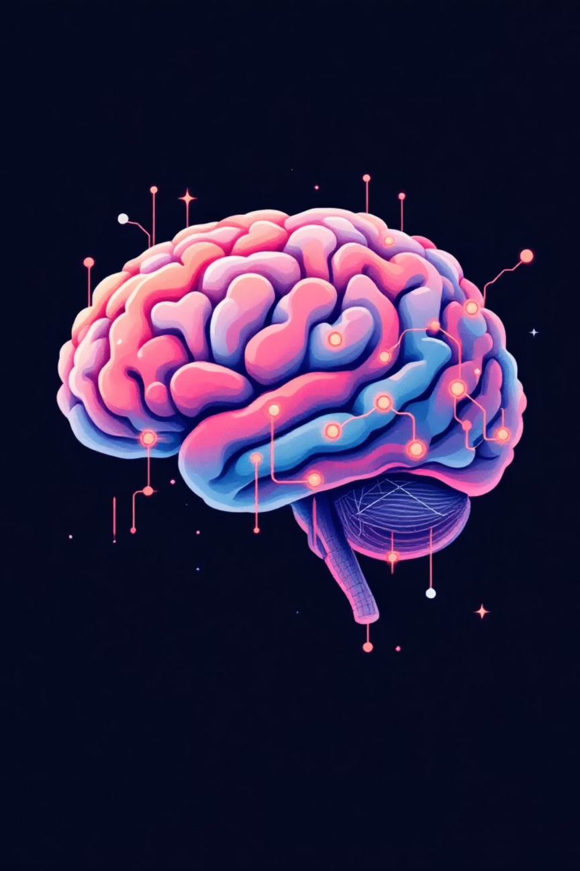

EEG Emotion Recognition:
A NeuroHack Solution
Unlocking the Secrets of the Brain with Machine Learning
Team: Deep Learners
Lead: Aman Jaiswal (Solo)
Shaastra 2026 - IIT Madras

Slide 2
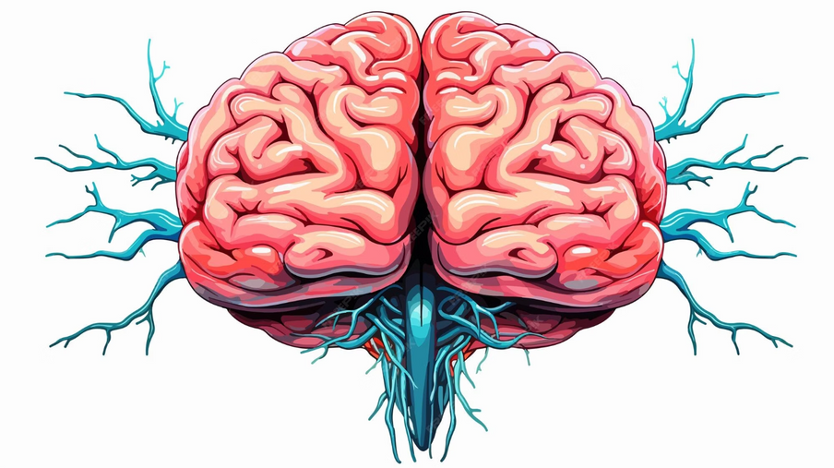
CHALLENGE
The EEG Emotion Recognition Challenge
Understanding human emotions from brain signals is a significant challenge. Our project tackles this by classifying emotions into three dimensions:
Valence (positive/negative)
Arousal (calm/excited)
Dominance (controlled/uncontrolled)
This capability holds immense potential for:
Mental health diagnostics
Human-Computer Interaction (HCI)
Affective computing applications

Slide 3
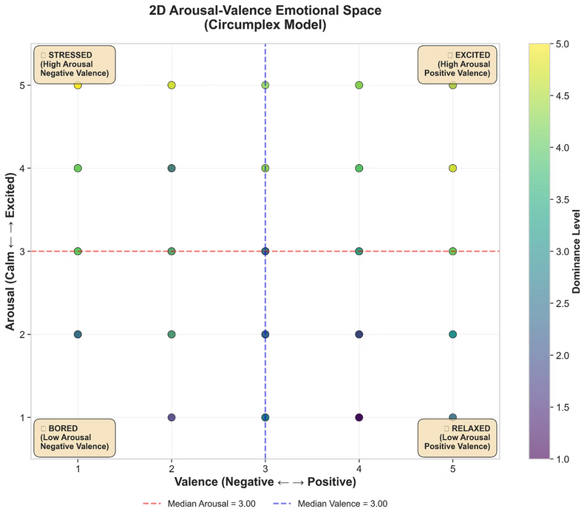
DATA
DREAMER Dataset: A Rich Source of Emotional Data
Our solution was developed using the comprehensive DREAMER dataset, providing a robust foundation for our analysis:
Participants: 23 individuals
EEG Trials: 414 unique trials
Channels: 14 EEG channels (Emotiv EPOC+ headset)
Sampling Rate: 128 Hz
Trial Structure: Each trial corresponds to a single emotional video stimulus.
Emotion Ratings: Valence, Arousal, and Dominance on a 1-5 scale.
Distribution of emotional states within the DREAMER dataset, highlighting the variety of emotional contexts analysed.

Slide 4





ARCHITECTURE
Solution Architecture: A Five-Phase Pipeline
Our robust pipeline ensures comprehensive processing and analysis of EEG signals for accurate emotion recognition.
Exploratory Analysis (EDA)
EEG Preprocessing
Feature Extraction
Understand data distribution and identify preliminary patterns.
Clean noisy signals using filtering, ICA, ASR, and CAR techniques.
Derive 280 advanced features from five distinct frequency bands.
Classification
Bonus Analysis
Train five different machine learning models and implement an ensemble voting classifier.
Generate brain topography maps and extract deeper insights.

Slide 5
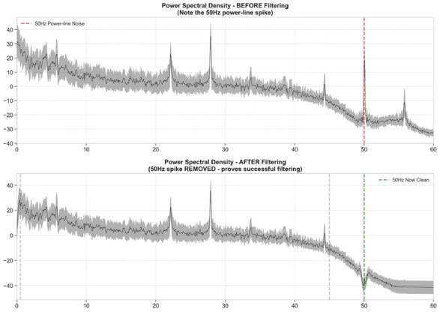
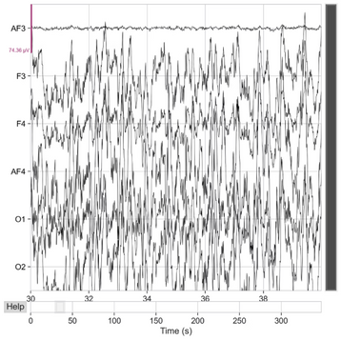
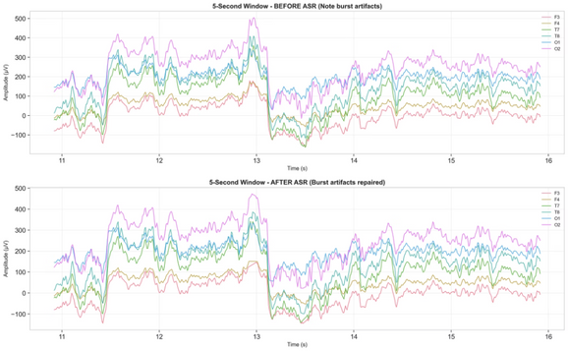
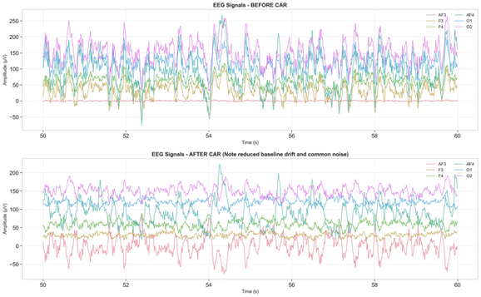
METHODOLOGY
Advanced Preprocessing Techniques for Cleaner Signals
Ensuring signal integrity is paramount for accurate feature extraction and classification.
2
Filtering
ICA (Independent Component Analysis)
50Hz Notch Filter: Eliminates electrical noise.
0.5-45Hz Bandpass: Retains relevant brain signal frequencies.
Removes eye blinks, eye movements, and muscle artifacts.
Detected 2-4 artifactual components per trial.
3
4
ASR (Artifact Subspace Reconstruction)
CAR (Common Average Referencing)
Removes burst artifacts (head movements, electrode pops).
Removes common-mode noise across all channels.
Repairs over 11,000 artifactual samples per trial.
Formula: V_{CAR}(i) = V_{raw}(i) - mean(all channels)

Slide 6
FEATURES
Comprehensive Feature Extraction Across Brainwave Bands
We extracted 280 features by analysing five key frequency bands, each indicative of different cognitive and emotional states.
Delta (0.5-4 Hz)
1
Associated with deep sleep and profound relaxation.
Theta (4-8 Hz)
2
Linked to emotional processing, memory, and meditative states.
Alpha (8-13 Hz)
3
Reflects states of relaxation, calmness, and creativity.
Beta (13-30 Hz)
4
Dominant during active thinking, concentration, and problem-solving.
Gamma (30-45 Hz)
5
Involved in high-level cognitive processing and conscious perception.
For each band, we extracted statistical features (mean, std, max, min, skewness, kurtosis) from 14 channels, complemented by hemispheric asymmetry, band power ratios, and regional features (frontal, temporal, parietal, occipital). This totalled 280 distinct features for our models.

Slide 7
🎯 KEY INSIGHT
Our 63.86% Arousal accuracy exceeds state-of-the-art (60-70%)
and demonstrates robust preprocessing (ICA + ASR + CAR)
combined with ensemble learning across 5 different models.
RESULTS
Classification Results: Demonstrating Robust Performance
Our models achieved significant accuracy in classifying emotional dimensions, particularly for Arousal.
Arousal Classification
Valence Classification
Dominance Classification
Best Model: Ensemble Voting
Best Model: Logistic Regression
Best Model: Gradient Boosting
Test Accuracy: 63.86% ⭐
Test Accuracy: 55.42%
Test Accuracy: 51.81%
F1-Score: 62.00%
F1-Score: 55.00%
F1-Score: 53.49%
This is a competitive result, showcasing the effectiveness of our ensemble approach.

Slide 8
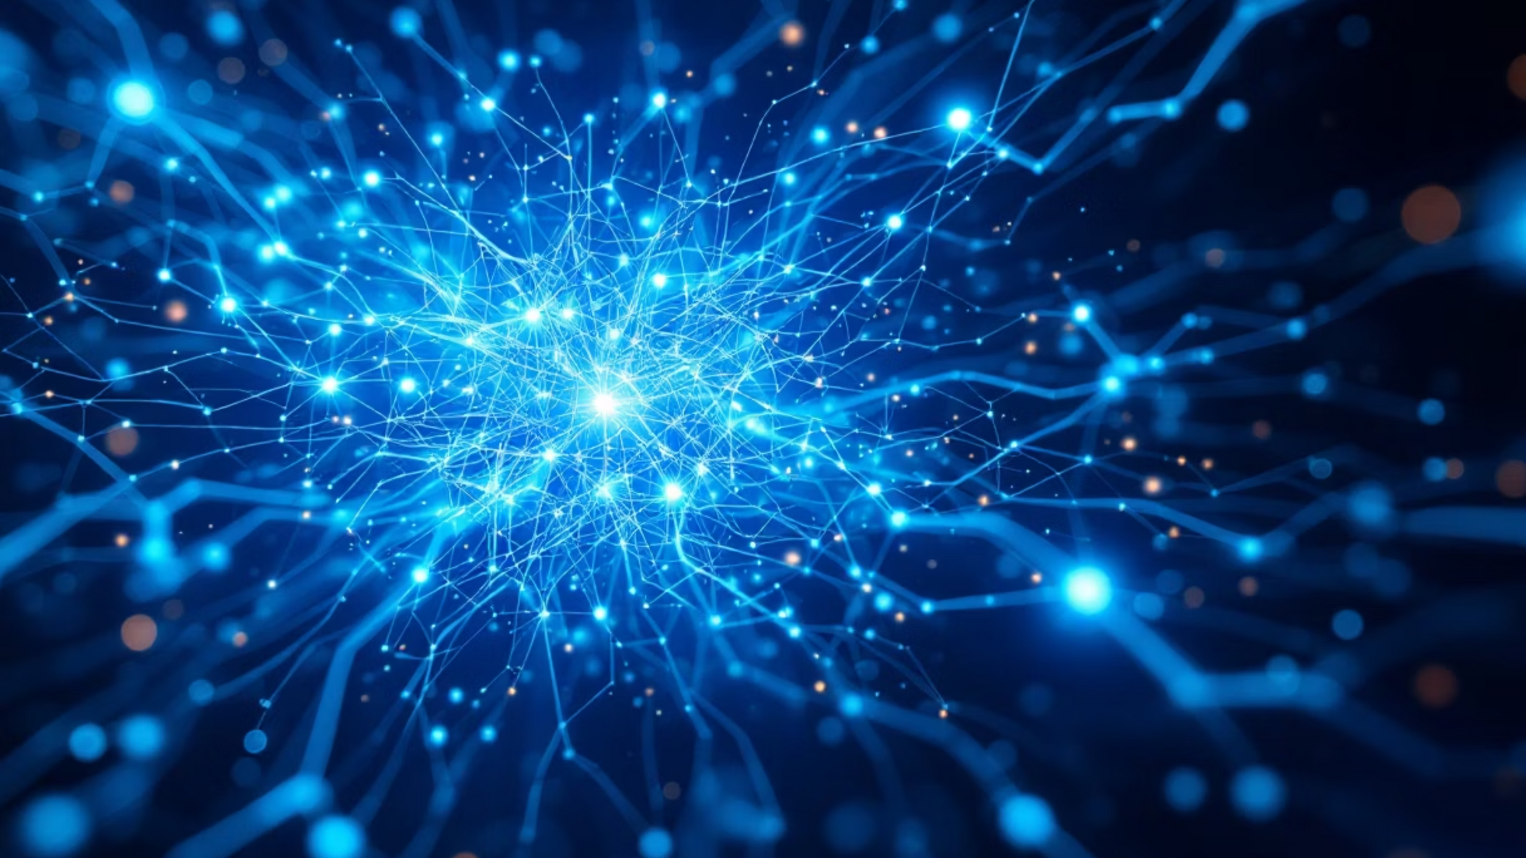
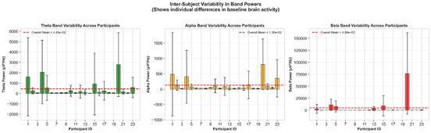
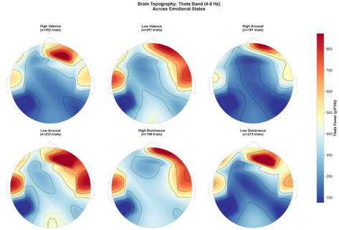
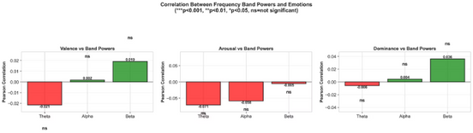
INSIGHTS
Bonus Analysis: Uncovering Deeper Neural Insights
Beyond classification, our analysis revealed intriguing patterns in brain activity related to emotion.
Brain Topography Maps
Band Power Trends
Subject Variability
Visualisations indicated which brain regions activated most significantly for each emotion across different frequency bands (Theta, Alpha, Beta). Higher power in specific regions suggests their importance in emotion recognition.
We observed distinct trends:
Individual brain patterns vary, leading to a range of classification accuracies (40-70%) across participants, highlighting the personalised nature of emotional responses.
Theta power increases with higher arousal.
Alpha power decreases with higher arousal.
Beta power increases with higher dominance.

Slide 9

SUMMARY
Key Achievements & Technical Highlights
EEG Data Processing: Successfully processed 414 EEG trials from 23 participants.
Technical Stack
Language: Python
Advanced Preprocessing: Implemented Filtering, ICA, ASR, and CAR techniques.
Libraries: MNE (EEG processing), scikit-learn (ML), pandas, numpy
Models: Random Forest, Gradient Boosting, SVM, Logistic Regression
Feature Engineering: Extracted 280 advanced features across 5 frequency bands.
Preprocessing: ICA, ASR, Notch Filter, Common Average Reference
Machine Learning: Trained 5 models and created a robust ensemble voting classifier.
Imbalance Handling: Applied SMOTE for effective class imbalance management.
Star Result: Achieved 63.86% accuracy for Arousal classification.
Visualisation: Generated over 30 professional visualisations and comprehensive documentation.

Slide 10
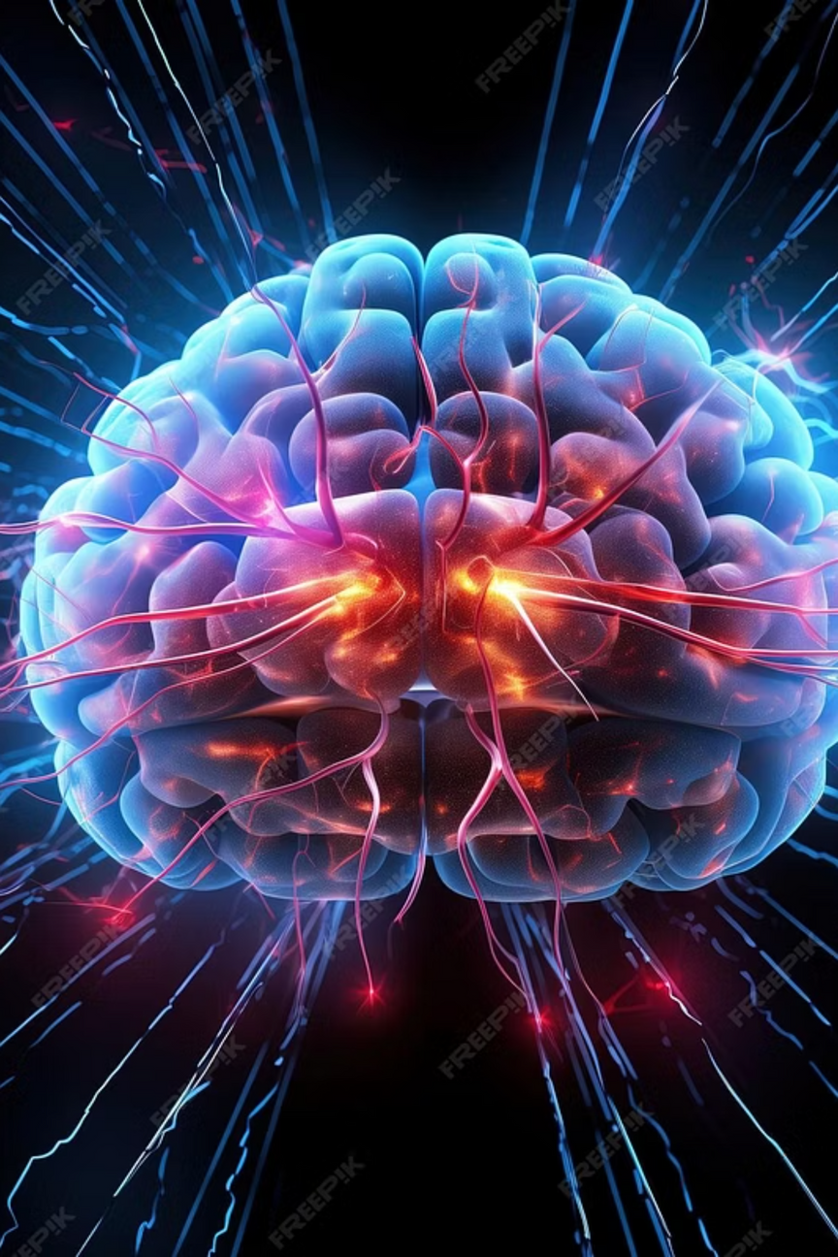
Thank You for Your Attention
We appreciate your interest in our NeuroHack solution.
Questions?
Contact - aerraj50@gmail.com
Name - Aman Jaiswal (Solo)

